Slide 1

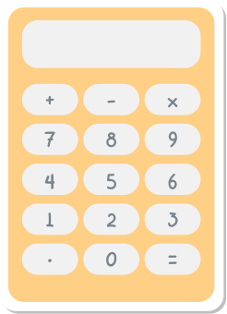











RATIOS
math lıfe

Slide 2

OBJECTIVES
Define ratios
1
  Learn how to solve ratios
  2
  Practice solving ratio word problems
  3
  Identify real-life applications
  4

Slide 3

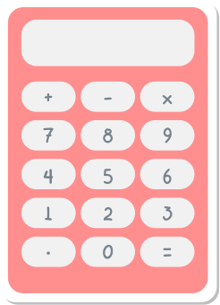
INTRODUCTION
A ratio tells us how much of one thing there is compared to another thing.
FOR EXAMPLE
For every two red calculators we have three yellow calculators.

Slide 4


TYPES OF RATIOS
  1
  2
  3
Part-to-Part
Part-to-Whole
Whole-to-Part
Compares the number of one part to another part of the whole.
Compares a selected number of parts to the total number of all parts in the whole.
Compares the total number of all parts in the whole to a selected number parts.

Slide 5

WAYS TO SHOW RATIOS
The same ratio can be written in three different ways.
1
  2
  3
4
four to six
4:6
6

Slide 6


SOLVING RATIOS
  1
  2
  3
Identify how many of each item is shown.
Write your ratio.
Simplify, if possible.

Slide 7
SOLVING RATIOS
  1
Identify how many of each item is shown.

Slide 8

SOLVING RATIOS
  2
12
4
Write your ratio.
Write the ratio of blue crayons to red crayons in simplest form.
12:4

Slide 9


SOLVING RATIOS
  3
÷2
÷2
Simplify, if possible.
12:4
6:2
3:1
Write the ratio of blue crayons to red crayons in simplest form.
÷2
÷2

Slide 10

REAL LIFE APPLICATIONS
1
  2
  3
Paint mixing
Cooking
Scaled drawings
To make lavender colored paint, mix 1 part violet to three parts white.
My mom’s famous cookie recipe has a two to one ratio of flour to sugar.
For every one inch on the drawing there is ten feet in real life.

Slide 11
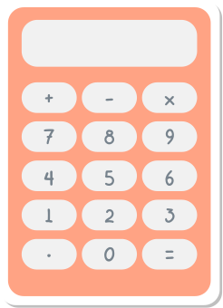
Can you think of another example of how you might use ratios in your life?

Slide 12






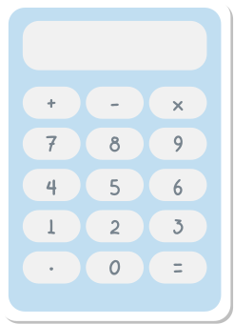

RESOURCES

